Slide 1
Putting Pen to Paper
Peter Bower
NIHR School for Primary Care Research, University of Manchester
Sabine van der Veer
Division of Informatics, Imaging and Data Sciences
David Schultz
Centre for Atmospheric Science, Dept of Earth and Environmental Sciences, and
Centre for Crisis Studies and Mitigation
Notes:
1

Slide 2
What is your experience of writing and submitting grant applications?
Go to menti.com and use code 7768 9998
Notes:
Menti-meter with 2 questions:
- Have you ever submitted a grant application? (however small) – can ask the room what funders and if people have been successful
What were (or would you expect to be) the key challenges throughout the process?

Slide 3
What you will learn in this session:
What is a strong rationale for a research project?
How to build and manage a team of co-applicants?
Understanding calls and funders
Highlighting value and impact
Communicating your ideas
Notes:
3

Slide 4
Two Fundamental Principles of Communication
Notes:
Science Communication: A Practical Guide for Scientists. Bowater and Yeoman, Wiley–Blackwell

Slide 5
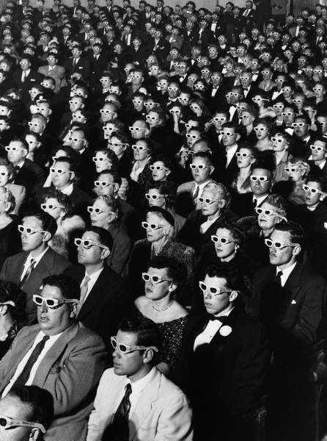

Audience
Message

Slide 6
So what?
The most important question you can ask about communicating your research
Notes:
Science Communication: A Practical Guide for Scientists. Bowater and Yeoman, Wiley–Blackwell

Slide 7
A strong rationale is a good research question linked to an important yet unmet clinical or population health need
Notes:
Science Communication: A Practical Guide for Scientists. Bowater and Yeoman, Wiley–Blackwell

Slide 8
Do you have a strong rationale for your research?
Lots of good science does not get funded, and occasionally some bad science does.
But, a strong rationale is the basis of having the best chance at funding.
Notes:
Science Communication: A Practical Guide for Scientists. Bowater and Yeoman, Wiley–Blackwell

Slide 9
Knowledge gaps alone are seldom a strong rationale for research. If no one has studied a particular topic, there might be a good reason. Not every knowledge gap is worth addressing. Instead, address gaps that help solve problems that matter.
https://lennartnacke.com/why-research-gaps-are-bullsh1t
Notes:
Research gaps are not the best way to motivate the research. Not all gaps are important. https://lennartnacke.com/why-research-gaps-are-bullsh1t/ That is why we advocate for a problem statement to motivate the research.

Slide 10
Instead of asking "What hasn't been studied?”, start with asking yourself: What are pressing clinical or public health problems, and how can my research help address these? What are the existing inconsistencies, tensions, or contradictions in the current understanding of these problems? What are the limitations of current approaches and solutions, and why do these limitations matter?
Based on: https://lennartnacke.com/why-research-gaps-are-bullsh1t
Notes:
Research gaps are not the best way to motivate the research. Not all gaps are important. https://lennartnacke.com/why-research-gaps-are-bullsh1t/ That is why we advocate for a problem statement to motivate the research.

Slide 11
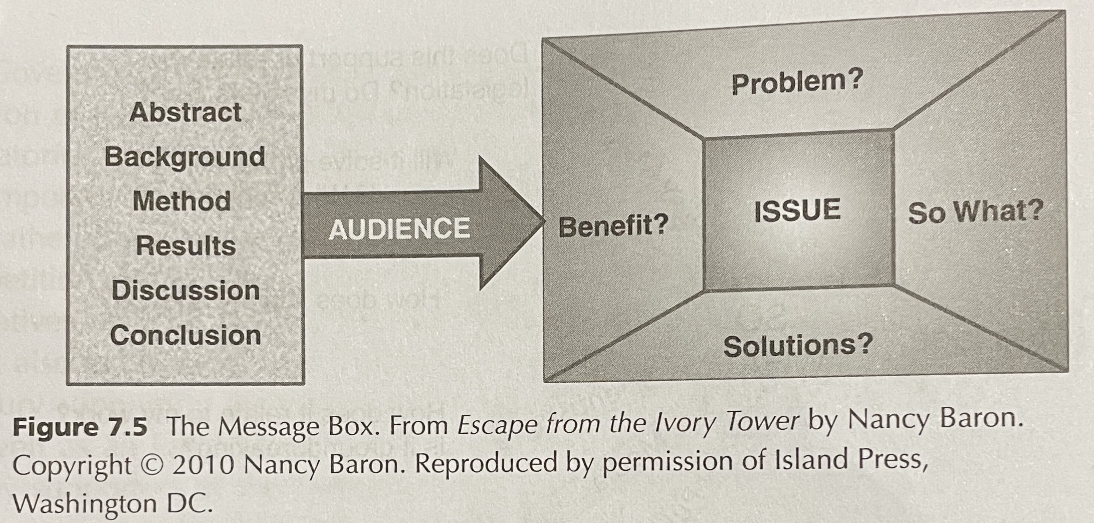
The Message Box as a tool to construct your proposal
Bowater and Yeoman (2013): Science Communication: A Practical Guide for Scientists.
Notes:
Science Communication: A Practical Guide for Scientists. Bowater and Yeoman, Wiley–Blackwell

Slide 12
The message box can help you:
Craft the rationale for your proposal
Polish your critical literature review
Explain to nonscientists what you do
Prepare for interviews
Refine your elevator speech

Slide 13
Clinical or public health need
ISSUE: In broad terms, what is the overarching issue or topic?
PROBLEM: What is the particular problem or piece of the issue I am addressing?
SO WHAT?: Why does this matter to others?
Knowledge gap (research question)
SOLUTIONS: What is (still un) known about the potential solutions to the problem?
BENEFITS: What is (still un) known about the potential benefits from resolving the problem?

Slide 14
Example message box
Issue: x million people live with disease Y which negatively impacts their quality of life
Problem: exposure Z causes the disease to progress but assessment is infrequent and currently relies on self-report
So what: this means the disease is suboptimally managed, with many people progressing unnecessarily quickly
Solution: research in another disease showed approach B improved assessment but unclear if and how this translates
Benefits: evidence that feedback on exposure Z supports self-management but clinical utility is still unknown

Slide 15
Now you have a go defining a message box for your project
Notes:
Two options for activity (both take ~20 mins incl feedback but option 1 more likely to overrun)
People find their group to do this for their project – then ask 2 groups to report back [preferred]
People take 10 minutes to do this on their own – then ask 2 people to report back

Slide 16
Question, aim, objectives
Research question: central question of your study (linked to knowledge gap)
Aim: what you want to achieve with your research (i.e., answer your research question)
Objectives: how you will achieve your aim (strong link to your methods and deliverables)
All should follow logically from your rationale and ultimately contribute to addressing the clinical/health need

Slide 17
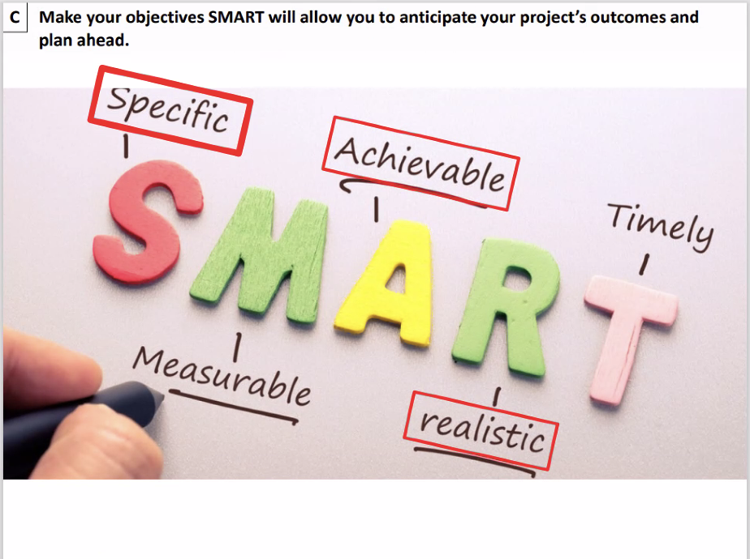
(Jean-Baptiste Koehl)

Slide 18
Example message box
Issue: x million people live with disease Y which negatively impacts their quality of life
Problem: exposure Z may cause disease Y to progress but assessment is infrequent and currently relies on self-report
So what: this means disease Y is suboptimally managed, with many people progressing unnecessarily quickly
Solution: research in another disease showed approach B improved assessment but unclear if and how this translates
Benefits: evidence that feedback on exposure Z supports self-management but clinical utility is still unknown

Slide 19
Example aim & objectives
Aim: Improve assessment of exposure Z to inform treatment of disease Y (using approach B) [problem]
Objectives: [unknowns re: solutions & benefits]
Test accuracy of approach B to assess exposure Z in people with disease Y in (a) controlled and (b) real-world settings
Explore the clinical utility of approach B to inform treatment of disease Y
Ultimately, this will contribute to enhancing management of disease Y, slow progression, and improve quality of life [issue; so what]

Slide 20
Now you have a go defining the aim and objectives for your project
Notes:
Follows on from previous message box activity (~10 mins)

Slide 21
Building and Managing Your Team of Co-applicants

Slide 22
What makes a good team?
Cover a range of:
Knowledge, skills, experience; career stages; institutions?; diverse demographic characteristics?
Previous work that the proposal is building on
Ideally, you have a track record of working together (publications, previous grants)
Strong leadership
This could be a less experienced person with high potential with support from a senior colleague

Slide 23
Managing the team
Involve co-investigators as early as possible with shaping the idea and proposal
Manage their expectations about their role, available support, and expected time investment
Described in project management section
Give them sufficient time to (1) sort out the admin (internal processes, budget for their salaries, etc.), and (2) provide feedback on your drafts

Slide 24
Background
on funding agency,
call for proposals

Slide 25
Know the context for the call for proposals. Are you eligible? Are there favored competitors due to how the call for proposals was written? Call the program manager to discuss your proposal, if possible.

Slide 26
What are they looking for? Pay attention to the criteria by which the proposal will be judged. Talk with prior applicants (particularly successful ones). Get copies of previous submissions.

Slide 27
Understand the panel

Slide 28
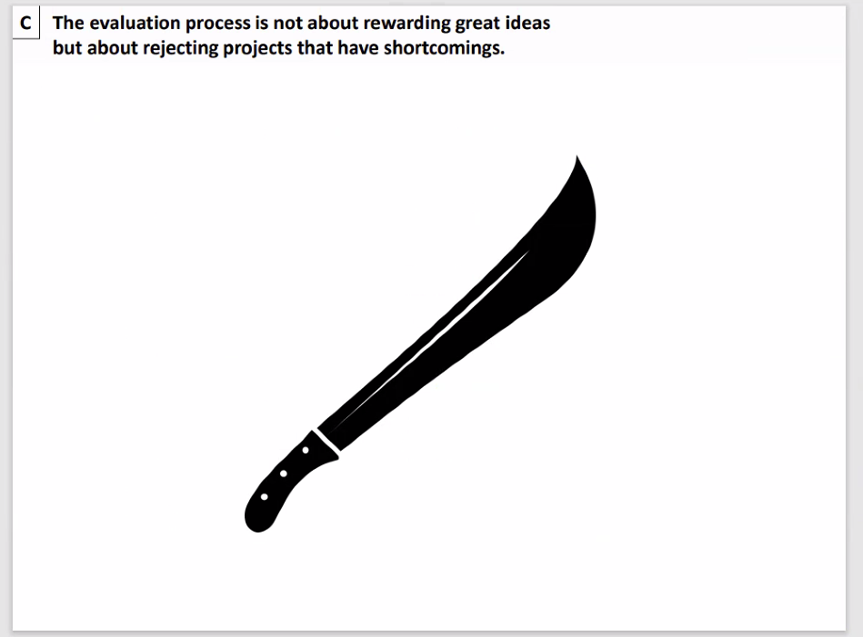
(Jean-Baptiste Koehl)

Slide 29
Know your audience, and write the proposal accordingly. Will generalists be on the panel? (Much more likely for awards and fellowships.) Will specialists be reviewing the proposal? What do your funders SAY they want to fund? Any relevant priority setting work?

Slide 30
Address the concerns of the reviewers/panel/funding agency.
Talk at a level that they can understand.
Use clever analogies, demonstrations, stories, or examples to explain difficult concepts.
Notes:
I haven’t heard many stories of how claiming you’re a synoptic meteorologist has increased personal wealth, brought fame, or even made someone more attractive to the opposite sex. Simply put, there aren’t many days where it is cool to claim you’re a synoptician. Today, however, is one of those days.
Synoptic meteorology has a reputation of being less rigorous than other disciplines, perhaps rightly so in some instances. But, Fred Sanders and his colleagues Dick Reed and Chester Newton, provided legitimacy to our discipline by merging the application of dynamics and quantitative diagnosis with the study of observed weather systems. For my talk, I want to review Fred’s contributions to synoptic meteorology, and focus on cold fronts, specifically.

Slide 31
Manage and mitigate risks in your proposal.
Things can and WILL go wrong.
Reviewers will expect you to have alternative plans.
Be proactive in addressing weaknesses, perceived weaknesses, and things that you don’t even imagine to be weaknesses.
Notes:
31

Slide 32
Value for Money and Pathways to Impact

Slide 33
Value for Money
Quality science is the primary aim
Value for money IS important, especially in decisions between bids (in commissioned calls) or when funding is highly constrained
Get a sense of levels of funding in previous bids of similar type, size
Show your working and prepare for negotiations!
Notes:
33

Slide 34
Impact
Funders increasingly focussed on impact
Major part of REF returns
Important to public contributors
Notes:
34

Slide 35
Impact
Think BROADLY
Who might be impacted? Who are the important decision-makers?
Types of impact
short, medium and long-term
diversity (further trials, changing attitudes and skills, economic productivity, patents and technology)
Logic models and mobilisation resources
Notes:
35

Slide 36
Finances:
Paying the Bills and Building a Budget

Slide 37
Structuring and writing the proposal

Slide 38
Ensure a strong opening to the proposal. Never underestimate the importance of first impressions.

Slide 39
Write a strong problem statement. The problem statement is the hinge around which your proposal rotates.

Slide 40
A good introduction has three parts.
Contextualizing background information
Grounds the reader in familiar information
Problem statement
Hook to get reader into the paper
Conflict, controversy, paradox, errors, unknowns, inconsistencies
Response to the problem
How are you going to resolve the problem statement?
Notes:
40
Gov

Slide 41
Background and Literature Synthesis
Should not read like a grocery list:
“Paper A did this. Paper B did that. Paper C did something else.”
Describe the topics, not the papers themselves.
Be complete, within reason and within scope of the proposal.
Be up to date.
Include references that disagree with each other and that you disagree with.
Notes:
41
Gov

Slide 42
Say why you are the best to solve this problem. If you don’t have the skills to deliver, how will you obtain those skills? Training? Collaboration?

Slide 43
Say why this problem is timely. Why is this research needed now?

Slide 44
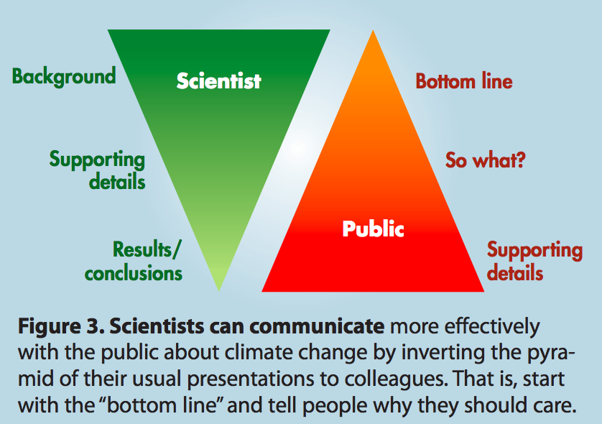
(Somerville and Hassol 2001, Physics Today)
Notes:
44

Slide 45
Get the killer material up front and be concise. In one or two paragraphs, give an overview of the proposal with background information, the problem statement, why the problem statement is bad, how only you are poised and able to save the day.

Slide 46
Which is the best opening sentence for a proposal? 1. “This proposal is about health app use and its effect on rates of depression.” 2. I am applying for a fellowship to support my research which is about the changing rates of depression in the context of mobile phone use.” 3. “Many scientists have been debating the role of app use on mental health.” 4. “Depression is increasing due to recent changes in people's use of phone apps.”

Slide 47
Follow the instructions precisely. Read the instructions multiple times during the preparation of the proposal.

Slide 48
Don’t neglect the aesthetics

Slide 49
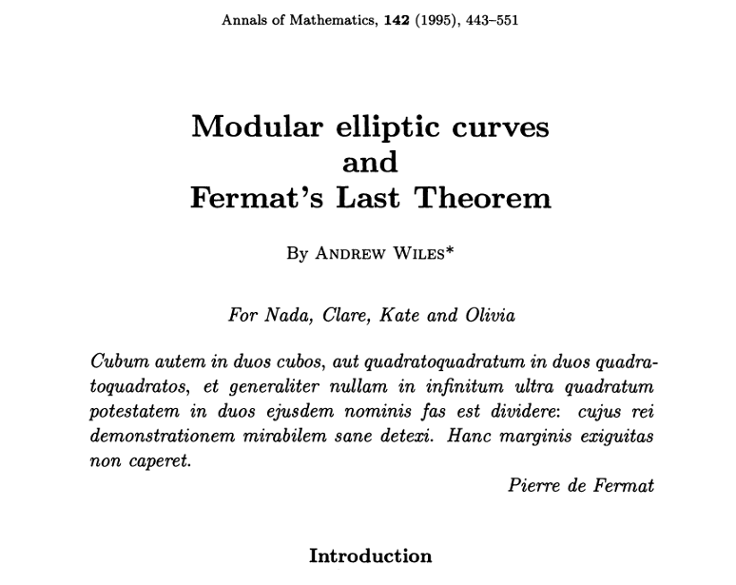

Slide 50
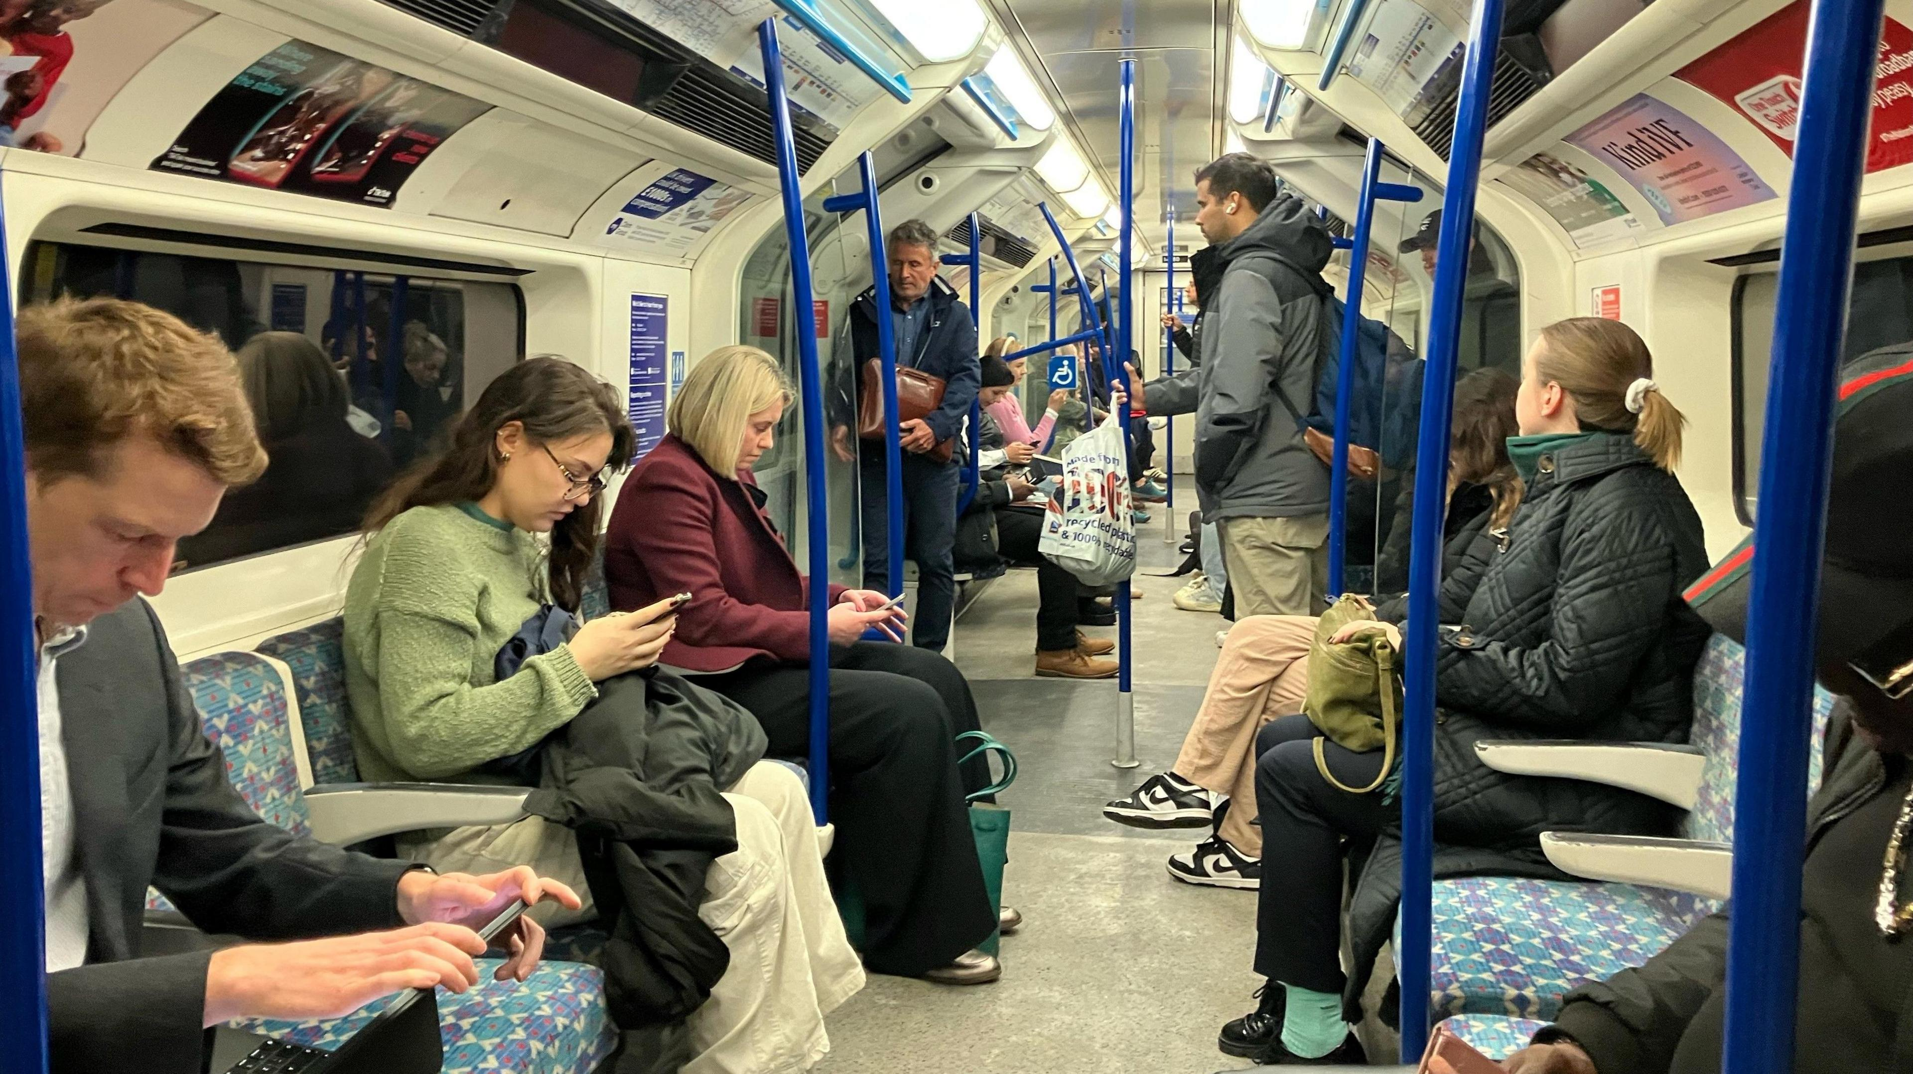

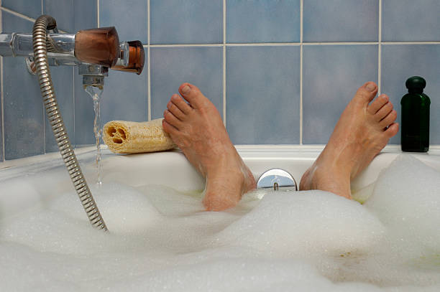

Slide 51
Make the submission readable, professional, and beautiful. Fill up the required fields, but don’t cram text into page limits Make the most of fonts (but don’t over do it) Word limits are maximums, not targets Use the skills of precision and concision to tighten the message in less text (“Omit needless words”)

Slide 52
Acronyms are supposed to make life easier for the reader not the author!
Spell out acronyms on first usage.
Avoid introducing new acronyms unless absolutely essential.
If you use an acronym only a few times, do not introduce it.
Notes:
52

Slide 53

Overcoming Barriers to Writing
Prof. David M. Schultz
https://bit.ly/BarriersToWriting
20-minute YouTube video
Notes:
53

Slide 54
Rebuttal
Interview
Rejection
Resubmission

Slide 55
‘Reading’ the response
Two factors
How strong are their concerns?
How strong are your preferences?
Any ‘strong’ clashes?

Slide 56
70/30 rule
Personal threshold – yours may differ!
Panels have spent time and effort on the review – expectation of response
But OK to pick a fight if needed
Pending replies – ‘if the panel feels strongly…’

Slide 57
Interview
All the advice on communication and presentation – but even more important
Don’t risk overruns on time
Short answers best (panel time pressure)
Similar issues in terms of rebuttals
Be aware of pros and cons, other options

Slide 58
Rejection and resubmission
Peer review is highly variable
Often panels facing closely ranked bids
Rejection can involve a justification of a marginal decision
Expectation should be to ‘go again’

Slide 59
Resources

Slide 60
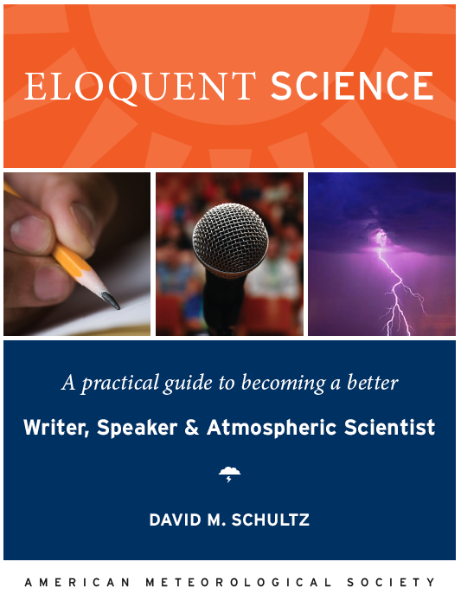
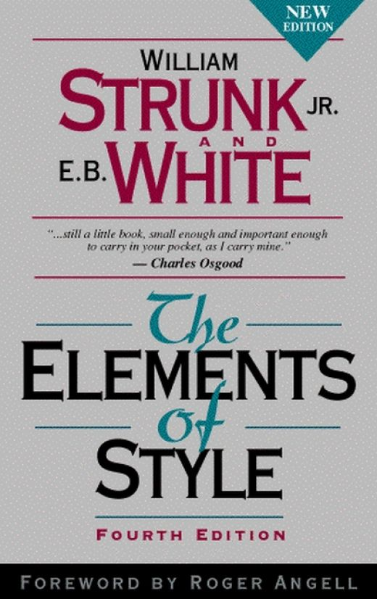
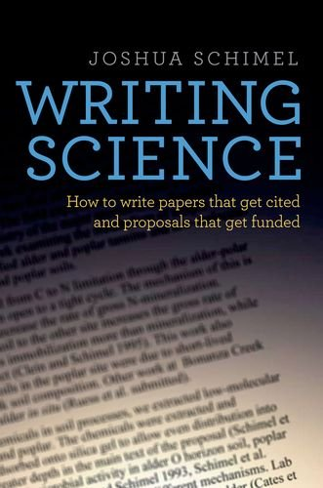
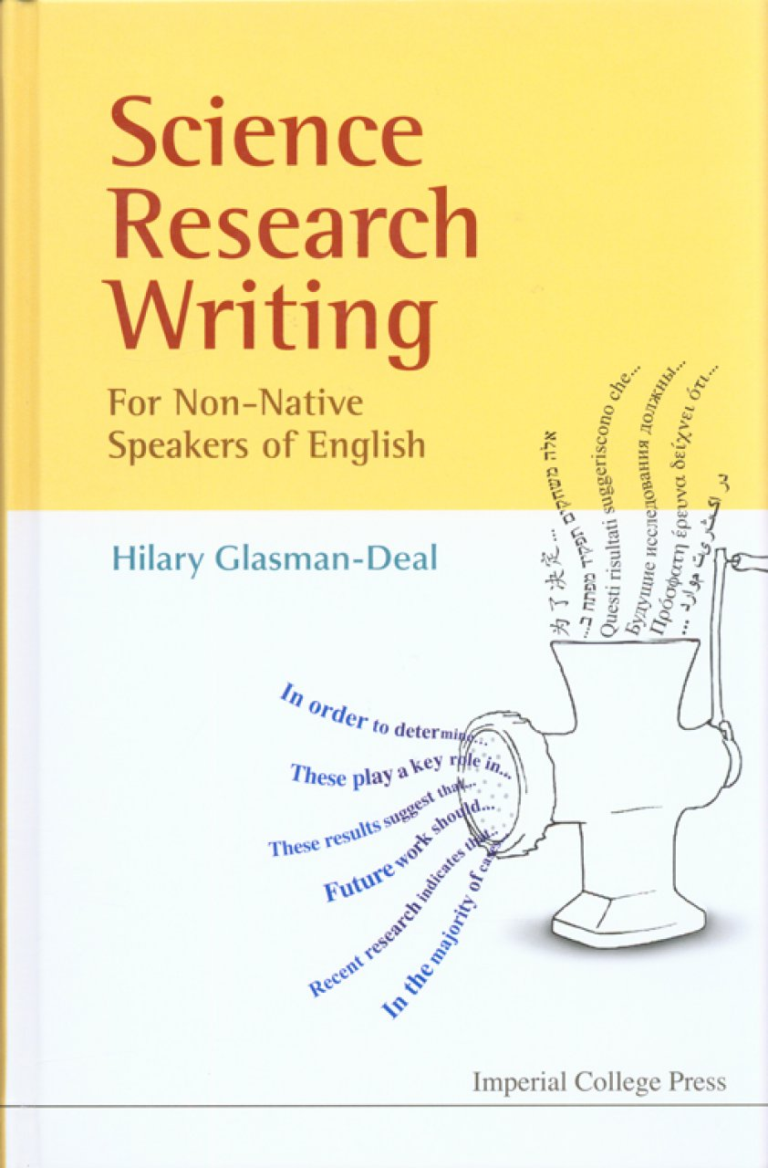
Maybe free access on campuses through Springer Link:
http://bit.ly/EloqSci
Gopen and Swan: “The Science of Scientific Writing”
www.eloquentscience.com

